Slide 1
Project 1
Deep Learning
Students: Karina Tiurina, Mateusz Zacharecki

Slide 2
Plan
CNN architecture
VGG-16
Voting ensemble

Slide 3
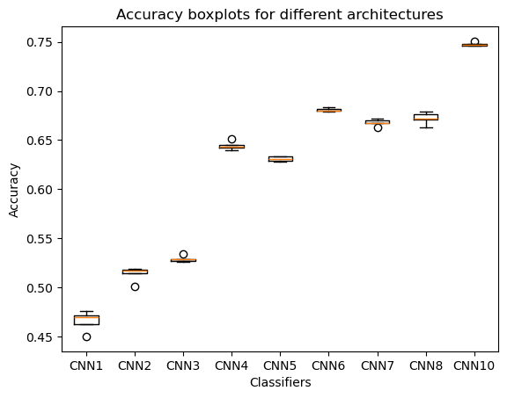
CNN
Best accuracy is 75% of CNN10: 6 convolutional layers, Adamax optimizer and augmentation.

Slide 4
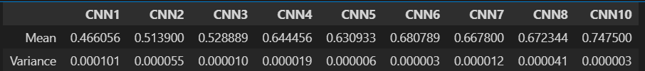
CNN
Each architecture training was repeated 5 times. The following table contains mean and variance of test set accuracy.

Slide 5
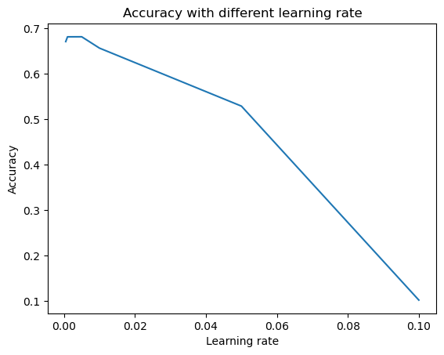
CNN
Learning rate tuning was done on the architecture with best accuracy – CNN6 containing 6 convolutional layers and Adamax optimizer.
Best learning rate is between 0.001 and 0.005

Slide 6
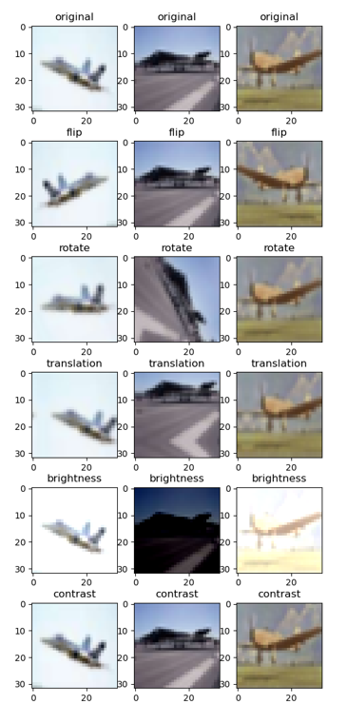
CNN
For augmentation each image in the training set was slightly changed 5 times.

Slide 7
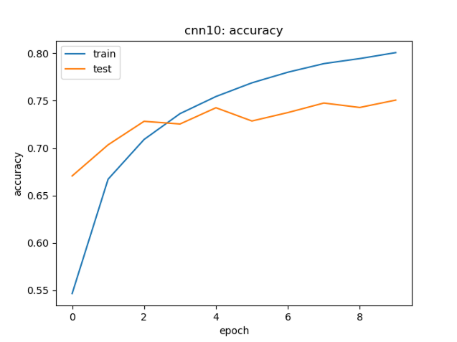
CNN10 Accuracy

Slide 8
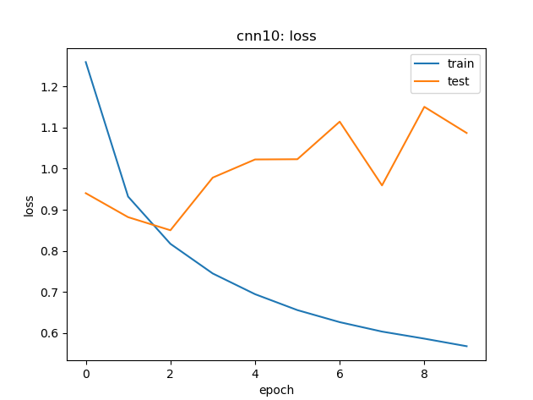
CNN10 Loss

Slide 9
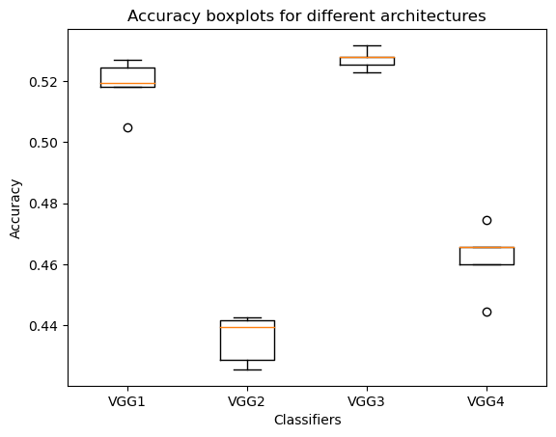
VGG16
The first 4 tests were performed 5 times, however, because of the evaluation time, the rest of tests were performed only once.

Slide 10


VGG
Table below contains mean and variance of accuracy for these four tested architectures.
Table 4.3 below contains accuracy for parameters tested only once, except VGG7, VGG8, VGG9 architectures.

Slide 11
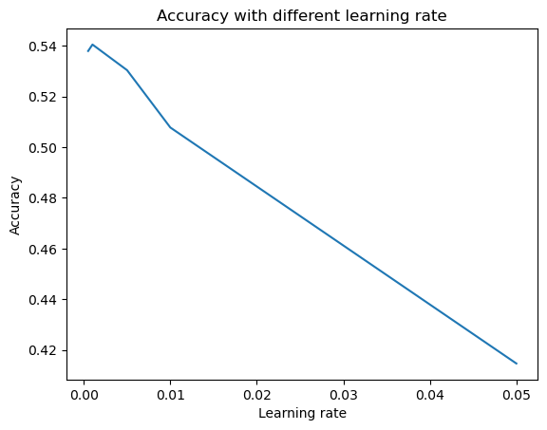
VGG7 Accuracy
Testing learning rate for Adamax optimizer.

Slide 12
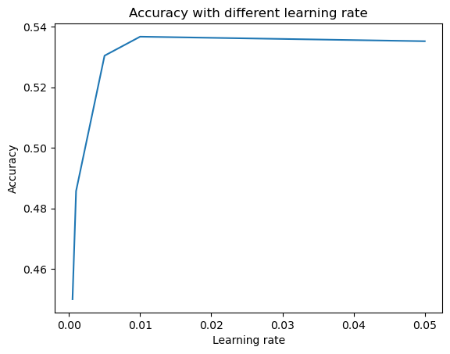
VGG8 Accuracy
Testing learning rate for Stochastic Gradient Descent optimizer.

Slide 13
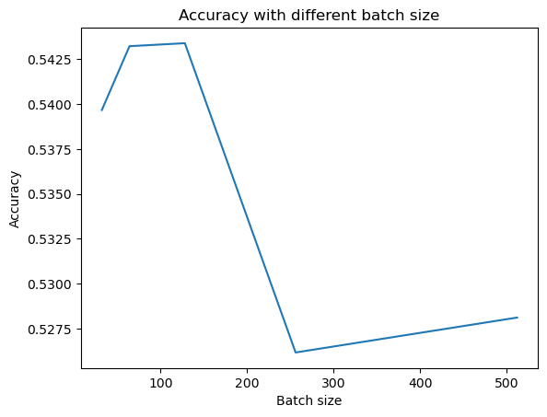
VGG9 Accuracy
Testing batch size.

Slide 14
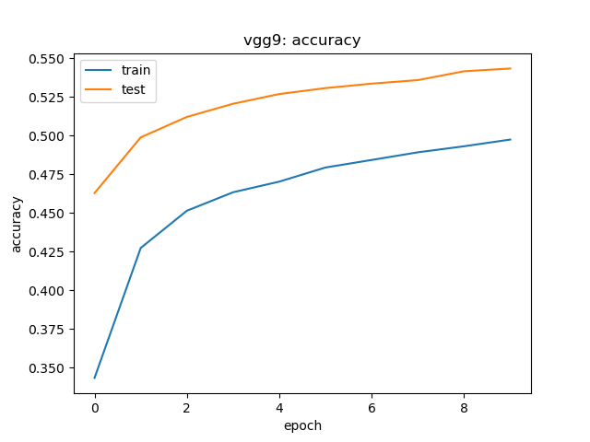
VGG9 with batch size = 128 Accuracy

Slide 15
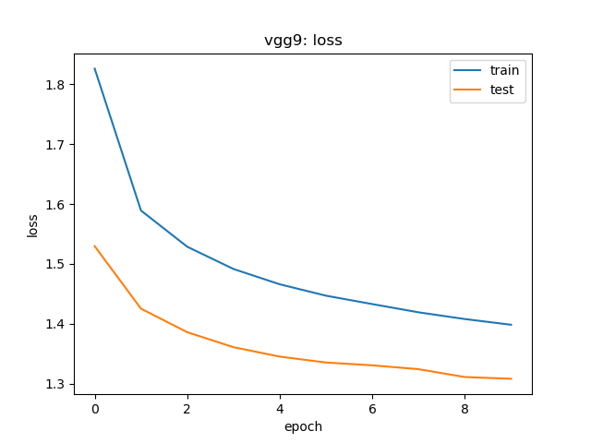
VGG9 with batch size = 128 Loss

Slide 16
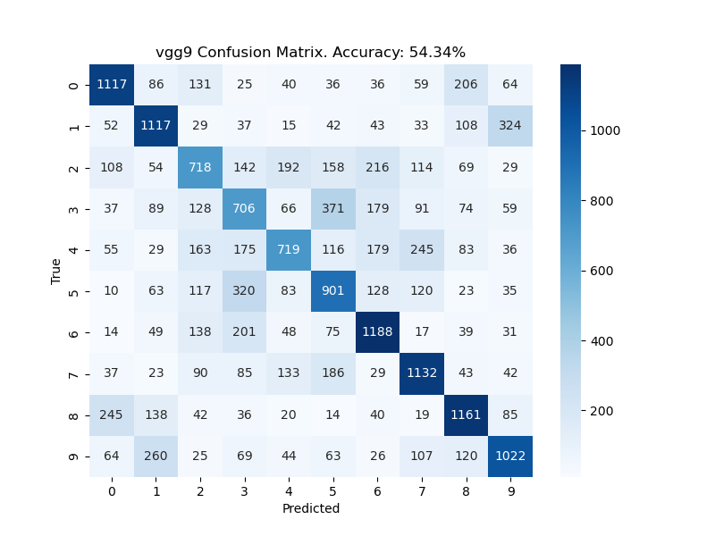
VGG9 with batch size = 128 Confusion matrix

Slide 17

Voting
The following table presents accuracies for considered voting ensembles.
Voting works good for VGG models, meanwhile results for CNN architecture are significantly worse.

Slide 18
Thank you for attention!

